Slide 1
104KM Enterprise Information System
Topic: Systems Analysis and Design – Part 2
Learning outcomes for today
Normalization
Data Redundancy
Functional Dependency
Process of Normalization
Summary

Slide 2
Normalization
Is a database technique that starts by examining the functional dependencies (Relationship) between attributes.
It employs a series of test (called normal forms) to identify the optimal grouping of attributes that support the enterprise’s data requirement.
Normalization is a technique for producing a set of relations with desirable properties, given the data requirement of an enterprise

Slide 3
Purpose of Normalization
Recalling that normalization is a technique for producing a set of relations with desirable properties, given the data requirement of an enterprise. We could say it’s purpose is to identify a suitable set of relations that supports the data requirement of an enterprise.
A database with a suitable set of relations is easier for the user to access and maintain the data whilst taking minimal storage space on the computer.

Slide 4
Purpose of Normalization
The characteristics used to identify a set of relations includes the following:
The minimal number of attributes necessary to support the data requirements of the enterprise;
Attributes with a close logical relationship (described as functional dependency) are found in the same relation;
Minimal redundancy, with each attribute represented only once, with the important exception of attributes that form all or part of foreign keys, which are essential for the joining of related relations.

Slide 5
How Normalization Supports Database Design
There are two main approaches for using Normalization;
Bottom-Up technique
Validation technique
Both approaches are aimed at creating a set of well-designed relations that meet the data requirements of the enterprise.

Slide 6
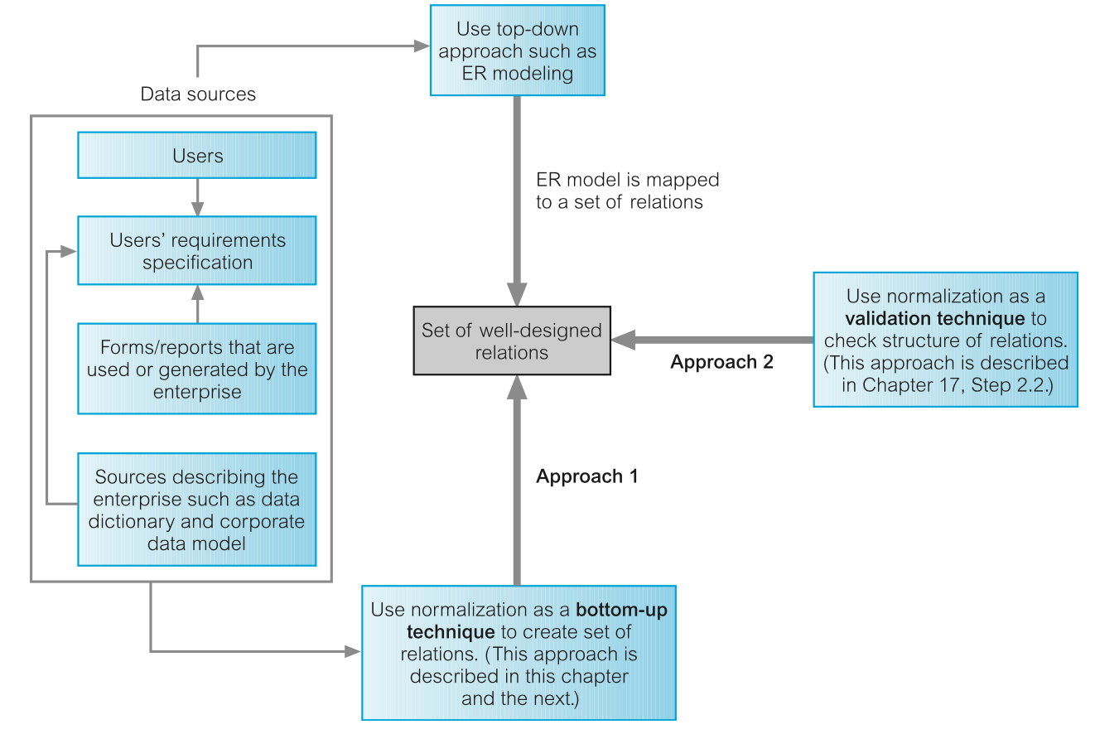
How Normalization Supports Database Design

Slide 7
Data Redundancy and Update Anomalies
Recalling, the main aim of database design is to group attributes into relations in order to minimize data redundancy.
The potential benefits for the implemented database includes;
Reducing data inconsistencies as a result to data update in the database
Reducing cost as a result of reduction in storage space

Slide 8
Data Redundancy and Update Anomalies
Relational database also relies on the existence of a certain amount of data redundancy
This redundancy is in the form of copies of primary keys (or candidate keys) acting as foreign keys in related relations to enable modelling of relationships between data.

Slide 9
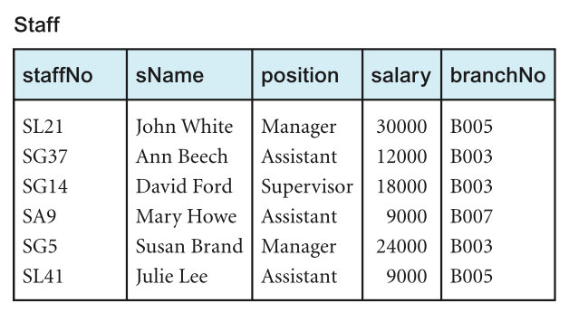
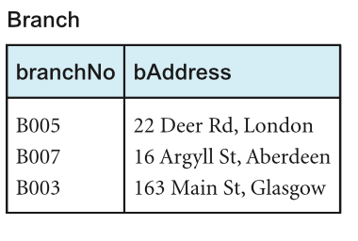
Example *
Let’s consider the Staff and Branch relation below with the relation having the following form
Staff (staffNo, sName, position, salary, branchNo)
Branch (branchNo, bAddress)
StaffBranch (staffNo, sName, position, salary, branchNo, bAddress)

Slide 10
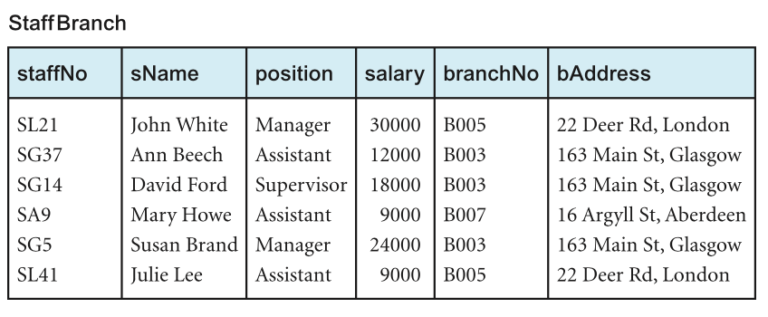
Example *
The problem associated with unwanted data redundancy can be illustrated by comparing the staff and Branch relations with the StaffBranch relation below

Slide 11
Example *
In the StaffBranch relation there is redundant data;
The details of a branch are repeated for every member of staff located at that branch.
In contrast;
The branch details appear only once for each branch in the Branch relation.
Only the branch number branchNo is repeated in the Staff relation to represent where each member of staff is located.
Relations that have redundant data may have problems called update anomalies, which are classified as insertion, deletion, or modification anomalies.

Slide 12
Insertion Anomalies
Insertion Anomaly occurs when certain attributes cannot be inserted into the database without the presence of another.
There are two main types of insertion anomaly, illustrated using the StaffBranch relation.
Inserting the details of a new staff member requires inclusion of the branch which the staff would be based.
Inserting details of a new branch that currently has no staff requires entering nulls into the attributes for staff. However, as staffNo is the primary key for the StaffBranch relation, attempting to enter nulls for staffNo violates entity integrity, and is not allowed.

Slide 13
Deletion Anomalies
Deletion Anomaly occurs when certain attributes are lost because of deletion of another attribute.
Deleting tuple from StaffBranch relation that represents the last member of staff located at a branch, the details about that branch are also lost from the database. E.g. deleting the tuple for SA9 (Mary Howe) from the StaffBranch relation, the details relating to branch number B007 are lost from the database.

Slide 14
Modification Anomalies
Modification Anomaly occurs when there is a change (addition, substitution or deletion) of data from the database.
Changing one attribute of a particular branch in the StaffBranch relation (e.g. address for branch B003), we must update the tuples of all staff located at that branch. Failure to do would result in inconsistence in the database (e.g. branch B003 may appear to have multiple addresses).

Slide 15
Anomalies
The examples illustrated by the three anomalies shows that Staff and Branch relations of Staff Branch have more desirable properties than the StaffBranch relation (i.e. StaffBranch relation is subjected to update anomalies)
This updates anomalies can be avoided by decomposing the original relation into the Staff and Branch relations.

Slide 16
Anomalies
Two important factors are associated with decomposition of a larger relation into smaller relations:
The lossless-join property: ensures that any instance of the original relation can be identified from corresponding instances in the smaller relations.
The dependency Preservation property: ensures that a constraint on the original relation can be maintained by simply enforcing some constraint on each of the smaller relations.

Slide 17
Functional Dependencies
Is an important concept associated with normalizationion that by describing the relationship between attributes in a relation.
It is a property of the meaning of the attributes in a relation. The semantics indicates how attributes relate to one another, and specify the functional dependencies between attributes.
When a functional dependency is present, the dependency is specified as a constraint between attributes.

Slide 18
Characteristics of Functional Dependencies
Let’s assume that a relational model has attributes with unique names (A, B, C, …… Z) and the database is described by a single universal relation called R = (A, B, C, …… Z).
If A and B are attributes of relation R, B is functionally dependent on A (denoted by A ® B), if each value of A is associated with exactly one value of B. (A and B may each consist of one or more attributes.)

Slide 19
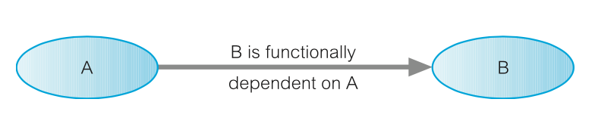
Characteristics of Functional Dependencies
Assuming we know the value of A and we examine the relation that holds the dependency, we find only one value of B in a all the tuples that have a given value of A, at any moment in time. Therefore, two tuples with the same value of A also have the same value of B. However, for a given value of B, there may be several different values of A
The dependency between attributes A and B is represented as shown above.

Slide 20
Determinant
In a functional dependency, the attribute or group of attributes on the left-hand side is referred to as the Determinant.
A is the determinant of B in the functional dependency above

Slide 21
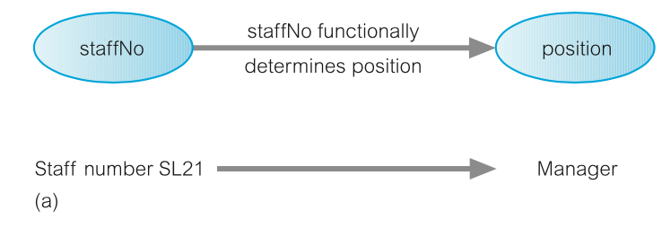
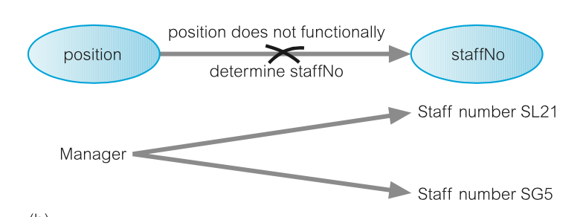
Example of Functional Dependency*
Consider the attribute staffNo and position of the Staff in the Staff and Branch relation. For a specific staffNo, we can determine the corresponding position of that staff. (i.e. staffNo functionally determines position)
The opposite is not true as position does not functionally determine staffNo

Slide 22
Example of Functional Dependency*
The relationship between staffNo and position is one-to-one (1:1) ( i.e. for each staff number there is only one position).
The relationship between position and staffNo is one-to-many (1:*) (i.e. Several staff numbers associated with a given position).
StaffNo is the determinant of this functional dependency.

Slide 23
Example of Functional Dependency*
The relationship between staffNo and position is one-to-one (1:1) ( i.e. for each staff number there is only one position).
The relationship between position and staffNo is one-to-many (1:*) (i.e. Several staff numbers associated with a given position).
StaffNo is the determinant of this functional dependency.

Slide 24
Example of Functional Dependency that holds for a long time*
Considering the values for staffNo an sName attributes, for a specific staffNo we can determine the name for that staff.
Therefore, we can conclude that staffNo attributes formally determines the sName attribute and/or sName attribute functionally determines the staffNo attribute.
Assuming the staffBranch relation shows all possible values for staffNo and sName, then the following functional dependency holds
staffNo ® sName
sName ® staffNo

Slide 25
Example of Functional Dependency that holds for a long time*
However, if the values represents a set off values for staffNo and sName attributes at a given moment in time, Then such relationship isn’t of interest.
As the functional dependency wouldn’t hold for all possible values for attributes of the relation. This is known as integrity constraints.
Integrity constraints indicates the limitations on the values a relation can legitimately assume.

Slide 26
Example of Functional Dependency that holds for a long time*
In this case, the relationship between staffNo and sName is one-to-one (1:1): for each staff number there is only one name. On the other hand, the relationship between sName and staffNo is one-to-many (1:*): there can be several staff numbers associated with a given name.
The functional dependency that holds is
staffNo ® sName

Slide 27
Full and Partial Functional Dependency
Additional characteristics of functional dependency necessary for normalization is that their determinant should have the minimal number of attributes necessary to maintain the functional dependency. This is called full functional dependency.
Full functional dependency indicates that if A and B are attributes of a relation, B is fully functionally dependent on A if B is functionally dependent on A, but not on any proper subset of A. (i.e. removal of any attribute from A results in the dependency no longer existing).
Partial functional dependency indicates that if A and B are attributes of a relation, B is partial functional dependent on A if there is some attribute that can be removed from A and yet the dependency still holds.

Slide 28
Example of Partial and Full Functional Dependency
Let’s consider the functional dependency below
staffNo, sName ® branchNo
Each value of (staffNo, sName) is associated with a single value of branchNo
However, It is not a full functional dependency as branchNo is also functionally dependent on a subset of (staffNo, sName) namely staffNo. This is an example of partial functional dependency.
The functional dependency would be
staffNo ® branchNo

Slide 29
Transitive Dependency
A condition where A, B, and C are attributes of a relation such that if A → B and B → C, then C is transitively dependent on A via B (provided that A is not functionally dependent on B or C).
Let’s consider the functional dependency below
staffNo ® sName, position, salary, branchNo, bAddress branchNo ® bAddress
The transitive dependency branchNo → bAddress exists on staffNo via branchNo. In other words, the staffNo attribute functionally determines the bAddress via the branchNo attribute and neither branchNo nor bAddress functionally determines staffNo.

Slide 30
Identifying Functional Dependency
Identifying all functional dependencies between a set of attributes can be achieved if the meaning of each attributes and the relationship between them are well understood through user requirement specification.
However, it may be necessary to for databases designer to provide missing information not provided by user specification.

Slide 31
Example - Identifying Function Dependency using Meaning and Relationship *
Assuming that the position held and the branch determine a member of staff’s salary. We identify the functional dependencies based on our understanding of the attributes in the staffBranch relation as:
staffNo ® sName, position, salary, branchNo, bAddress
branchNo ® bAddress
bAddress ® branchNo
branchNo, position ® salary
bAddress, position ® salary
We identify five functional dependencies with staffNo, branchNo, bAddress, (branchNo, position), and (bAddress, position) as determinants. For each functional dependency, we ensure that all the attributes on the right-hand side are functionally dependent on the determinant on the left-hand side.

Slide 32
Identifying Function Dependency using Sample data*
In a case where functional dependencies are to be identified in the absence of appropriate information about the meaning of attributes and their relationships, it may be possible to identify functional dependencies if sample data is available that is a true representation of all possible data values that the database may hold.

Slide 33
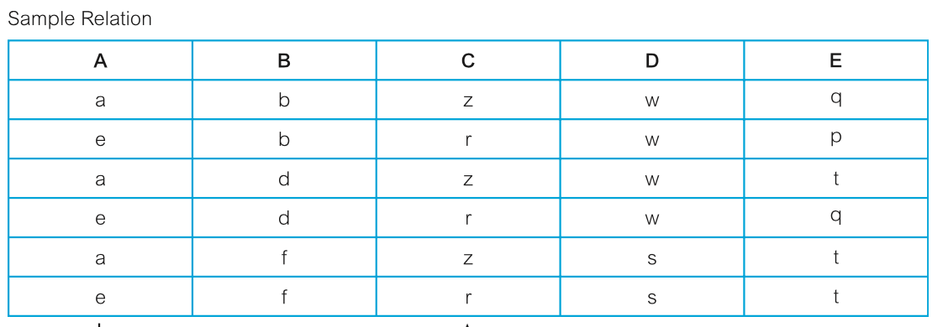
Example - Identifying Function Dependency using Sample data*
Consider the data for attributes denoted A, B, C, D, and A in the Sample relation below
First, it is important to establish that the data values shown in this relation are representative of all possible values that can be held by attributes A, B, C, D, and E.

Slide 34
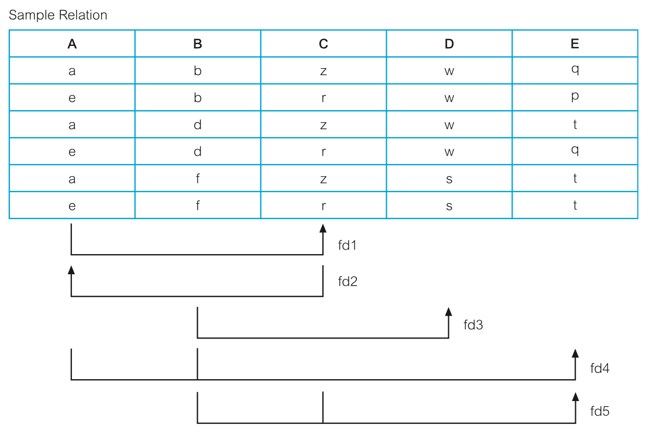
Example - Identifying Function Dependency using Sample data*
Let’s assume that the values represents all possible values that can be held by attributes A, B, C, D, and E. The process of identifying the functional dependencies (denoted fd1 to fd5) that exist between the attributes of the Sample relation is shown below

Slide 35
Example - Identifying Function Dependency using Sample data*
To identify the functional dependency, Starting with the first column on the left-hand side and working towards the right-hand side, we examine the Sample relation and identify when values in one column are consistent with the presence of particular values in other columns.
For example, when the value “a” appears in column A, the value “z” appears in column C, and when “e” appears in column A, the value “r” appears in column C. We can therefore conclude that there is a one-to-one (1:1) relationship between attributes a and C. In other words, attribute a functionally determines attribute C and this is shown as functional dependency 1 (fd1)

Slide 36
Example - Identifying Function Dependency using Sample data*
In summary, we describe the function dependencies between attributes A to E in the Sample relation as shown below:
A®C (fd1)
C®A (fd2)
B®D (fd3)
A,B®E (fd4)
B,C®E (fd5)

Slide 37
Identifying Relation’s Primary Key using Functional Dependency
Recalling that the aim of identifying a set of functional dependencies for a relation is to specify the set of integrity constraints that must hold on a relation.
The first integrity constraint to consider is the identification of candidate keys, one of which is selected to be the primary key for the relation.

Slide 38
Example - Identifying Relation’s Primary Key using Functional Dependency
Recalling the determinants functional dependencies identified earlier for the staffBranch relation staffNo, branchNo, bAddress, (branchNo, position), and (bAddress, position).
(Slide 31)
Identifying the candidate key(s) for the StaffBranch relation, requires identifying the attribute (or group of attributes) that uniquely identifies each tuple in this relation.
For relation with more than one candidate key, we identify the candidate key that is to act as the primary key for the relation.
All attributes that are not part of the primary key (non-primary-key attributes) should be functionally dependent on the key.

Slide 39
Example - Identifying Relation’s Primary Key using Functional Dependency
The only candidate key of the StaffBranch relation, and therefore the primary key, is staffNo, as all other attributes of the relation are functionally dependent on staffNo.
Although branchNo, bAddress, (branchNo, position), and (bAddress, position) are determinants in this relation, they are not candidate keys for the relation.

Slide 40
The Process of Normalization
Recalling normalization as a formal technique for analyzing relations based on their primary key (or candidate keys) and functional dependencies (Codd, 1972b).
The process of normalization involves a series of rules used to test individual relations so that a database can be normalized to any degree.

Slide 41
The Process of Normalization
Relations violating requirement must be decomposed into relations that individually meet the requirement of normalization.
Three normal forms called First Normal Form (1NF), Second Normal Form (2NF), and Third Normal Form (3NF) were initially used. Subsequently, an introduction of Boyce–Codd Normal Form (BCNF) is as a result of stronger definition of the third normal form by R. Boyce and E. F. Codd.

Slide 42
The Process of Normalization
With the exception of 1NF, all these normal forms are based on functional dependencies among the attributes of a relation (Maier, 1983).
Higher normal forms that go beyond BCNF were introduced later such as Fourth Normal Form (4NF) and Fifth Normal Form (5NF) (Fagin, 1977, 1979). However, these later normal forms deal with situations that are very rare. As such we shall not be covering them.
Normalization is often executed as a series of steps with each step corresponding to a specific normal form that has known properties.

Slide 43
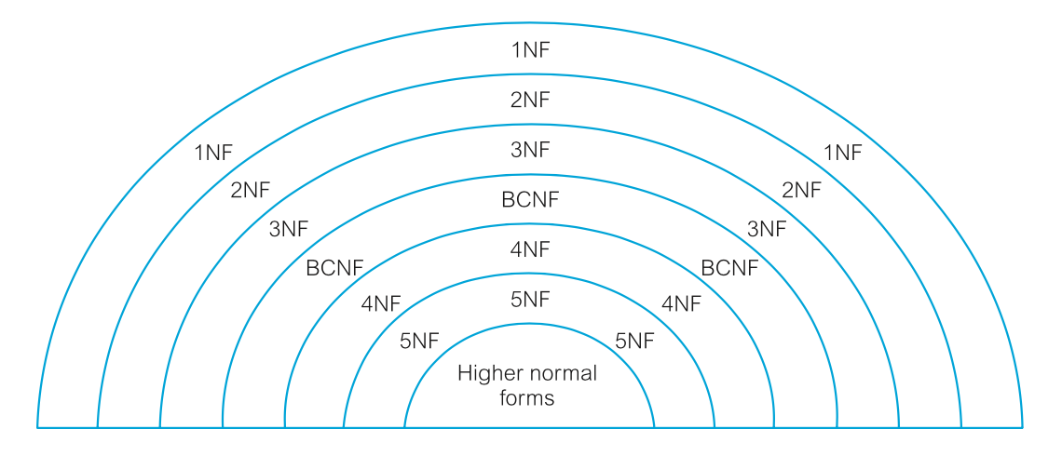
The Process of Normalization
As normalization proceeds, the relations become progressively more restricted in format and also less vulnerable to update anomalies.
For the relational data model, it is important to recognize that it is only First Normal Form (1NF) that is critical in creating relations; all subsequent normal forms are optional.
In other to avoid the update anomalies, it is recommended that we proceed to at least Third Normal Form (3NF).

Slide 44
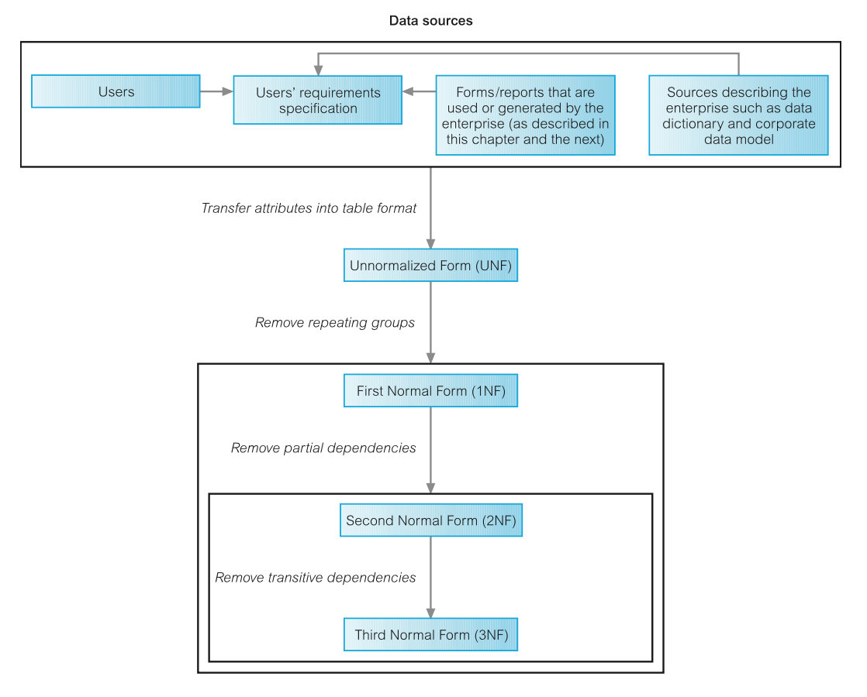
The Process of Normalization

